Slide 1
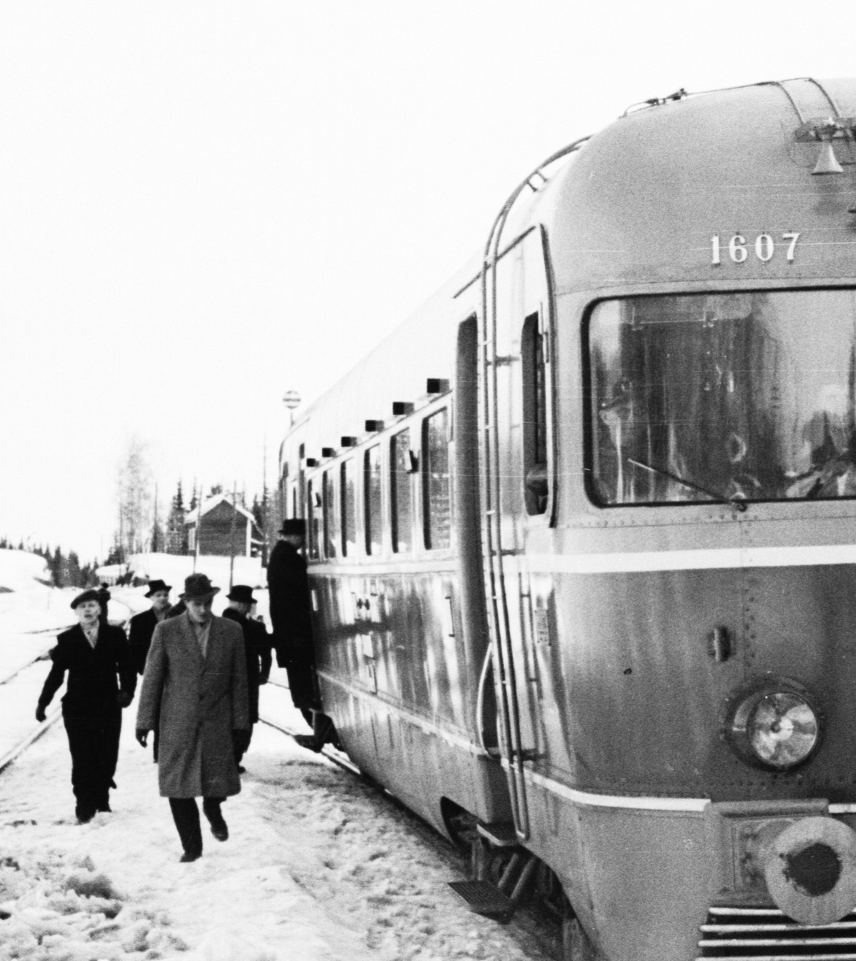
Using Cloud to Streamline R&D Workflow Predicting Train Delays
Finnish Meteorological Institute
Roope Tervo
Laila Daniel
Photo by Kalevi Lehtonen 1955. Not published until Commons in 2014. https://fi.wikipedia.org/wiki/Tiedosto:Finnish_class_Dm4_locomotive_number_1607_in_the_year_1955.jpg

Slide 2
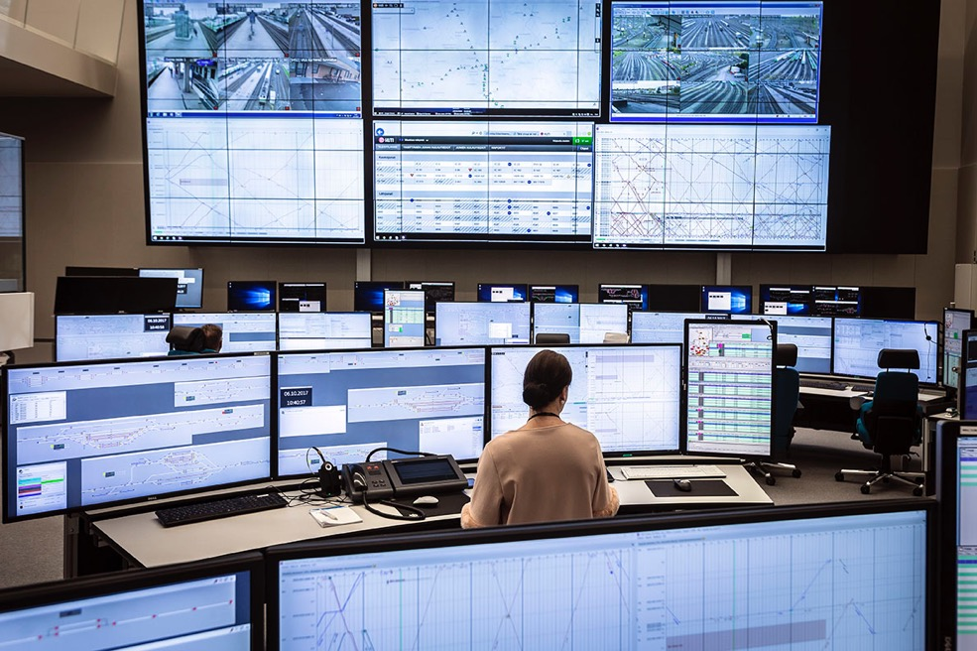
Image: Solita Oy
Notes:
Message: motivation for the work is to be able to provide a tool for the rail traffic operation center
Problem restricted strictly to weather – delays of other trains are not considered in prediction
1 year project (2018)
2

Slide 3
We aim to predict disruption of rail traffic caused by weather
Operation center can take several actions:
Get more workforce
Reduce train shifts
Communicate
Project timeline: 01/2018-10/2018
Project partners: IL, LiVi, Trafi, VR
Area: Finland
Time range: 2 days ahead
Time step: 1 hour
Image: Solita Oy
Notes:
Message: motivation for the work is to be able to provide a tool for the rail traffic operation center
They can take actions: put more workforce on field, reduce train shifts
Communications is also important for pr
3

Slide 4
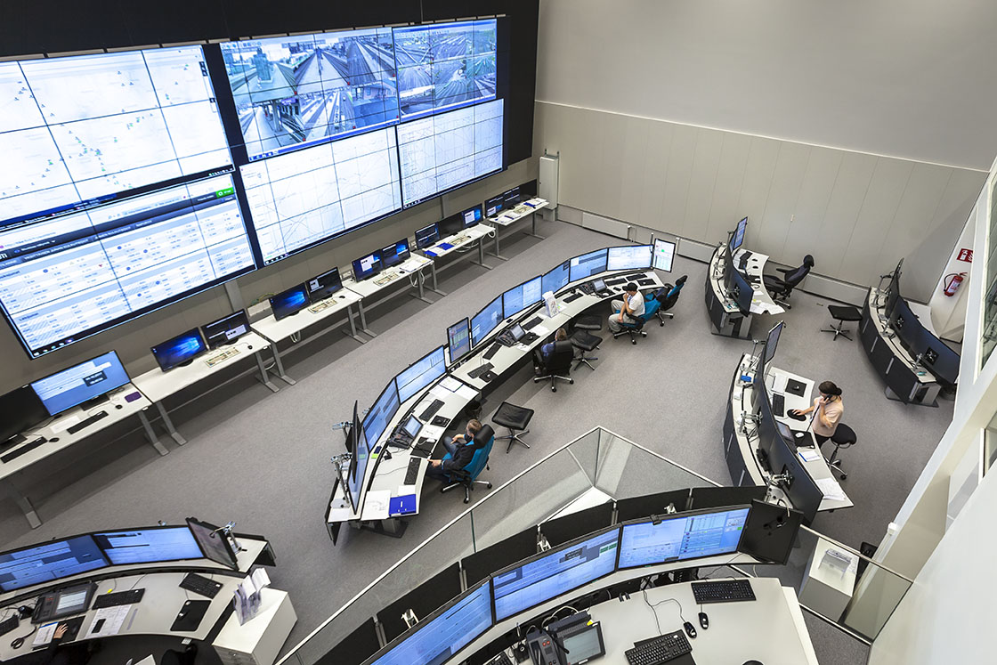
Two goals
Predict train delays
Evaluate Google Cloud Services
Image: Solita Oy
Notes:
Message: Goal was also to evaluate gcloud
4

Slide 5
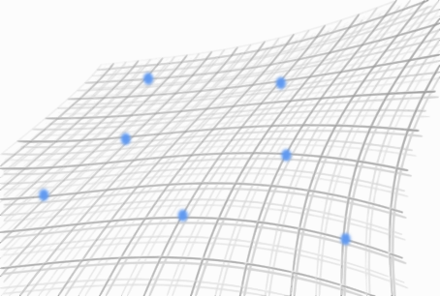
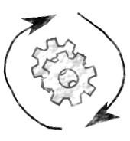
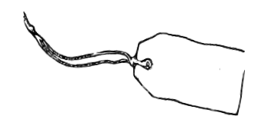
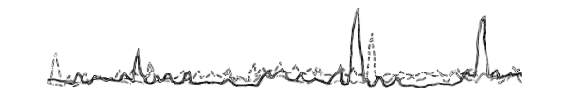
+
Label
data
Feature
data
Method
Results

Slide 6
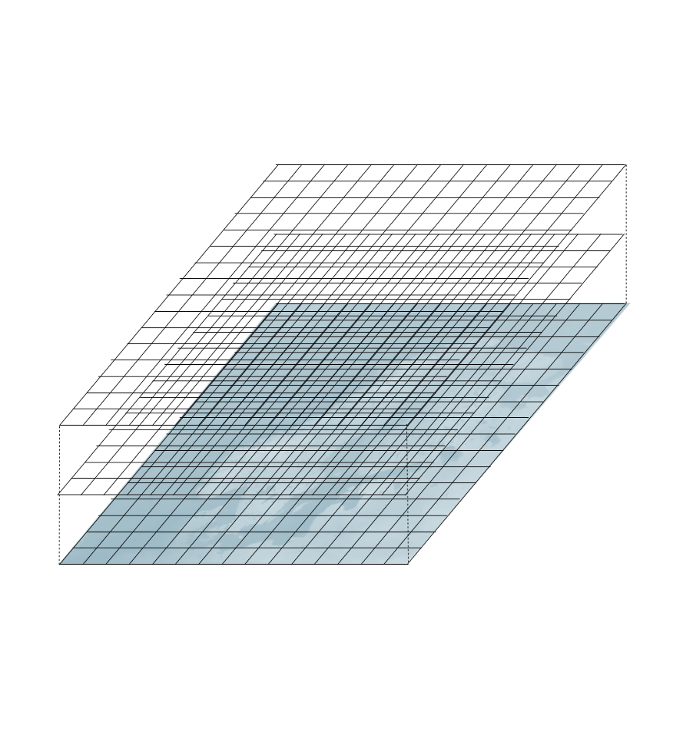
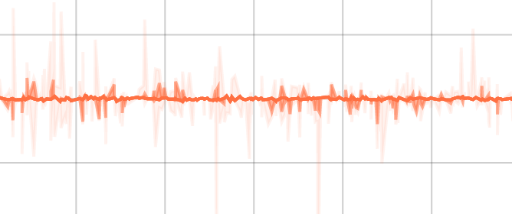
NWP
Method
Prediction

Slide 7
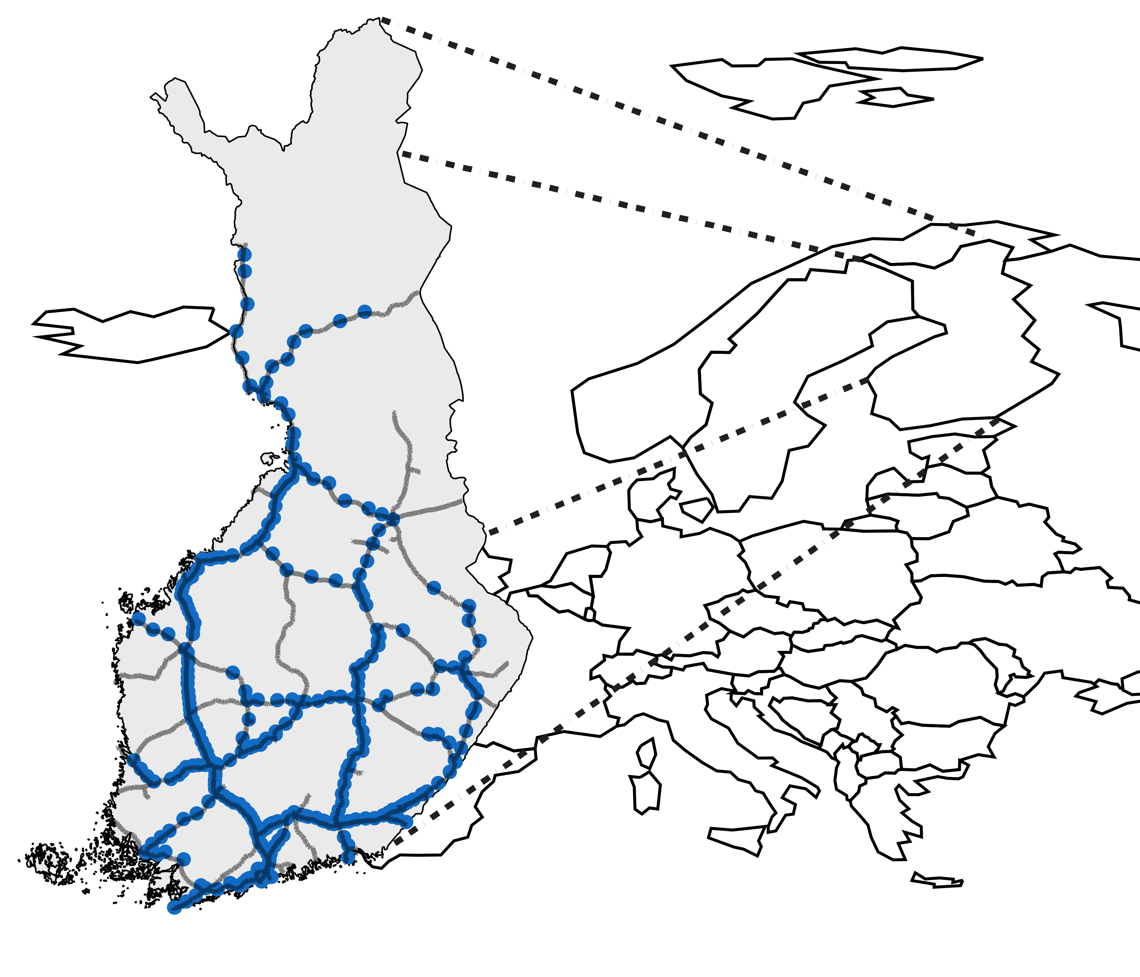
Data consist of train delays and corresponding weather observations
Delay between stations
Passenger trains
514 stations
Weather observations
19 parameters
Data from 2010 – 2018
30 M rows | 5.5 GB data
Data Liikennevirasto (CC4)
Notes:
Message: label data consists of trains delayed between stations
Length of history
Size of dataset
Passenger trains considered only
Other option as well
~10 trains per hour at busiest stations
Many stations host only few trains per day
Some stations contain only cargo traffic
Trains delayed at end station of the route
(minutes reported to every station to time stamp when train passed the stations
Four train types (intercity, commuter, cargo, other)
We consider only passenger trains
7

Slide 8
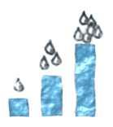
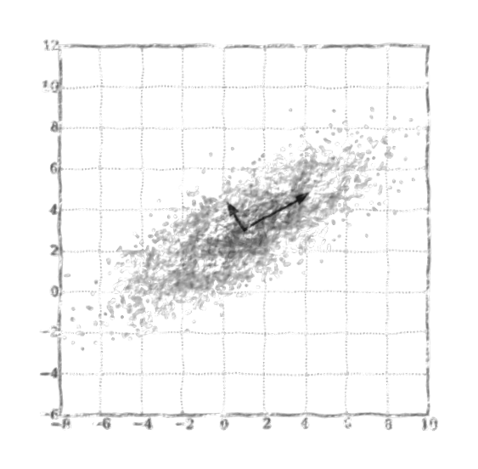
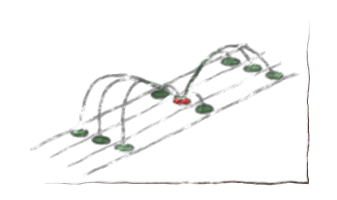
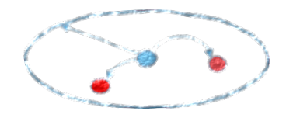
Various pre-processing methods used
Observations fetched with 100 km radius from train station using aggregation
Calculated 3h and 6h precipitation accumulation sums
Tried with and without imputation and normalisation
Tried PCA, ICA and K-Means clustering
100km
Image: Roope Tervo 2018. Original image: Mjanson srf. License: CC-BY-SA-3.0.
Image: Roope Tervo 2018.
Original image: Nicoguaro. License: CC4-BY.
Notes:
Message: various pre-processing methods used for the features
Observations fetched with 100 km radius from train station using aggregation functions (min/max/mean/count) to minimize amount of missing values
Calculated 3h and 6h precipitation accumulation sums
Tried with and without imputation and normalisation
Tried also PCA, ICA and K-Means clustering
8

Slide 9


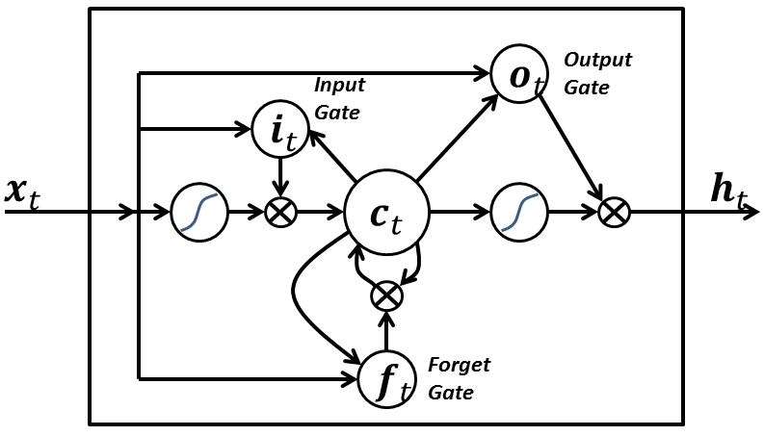
Three ML methods considered
LR
RFR
LSTM
Image: CC0
Image: Venkata Jagannath. License: CC4-BY
Image: BiObserver. License: CC4-BY
Random search used for finding optimal hyper parameters of LR and RFR
Notes:
Message: three separate ML methods considered
9

Slide 10
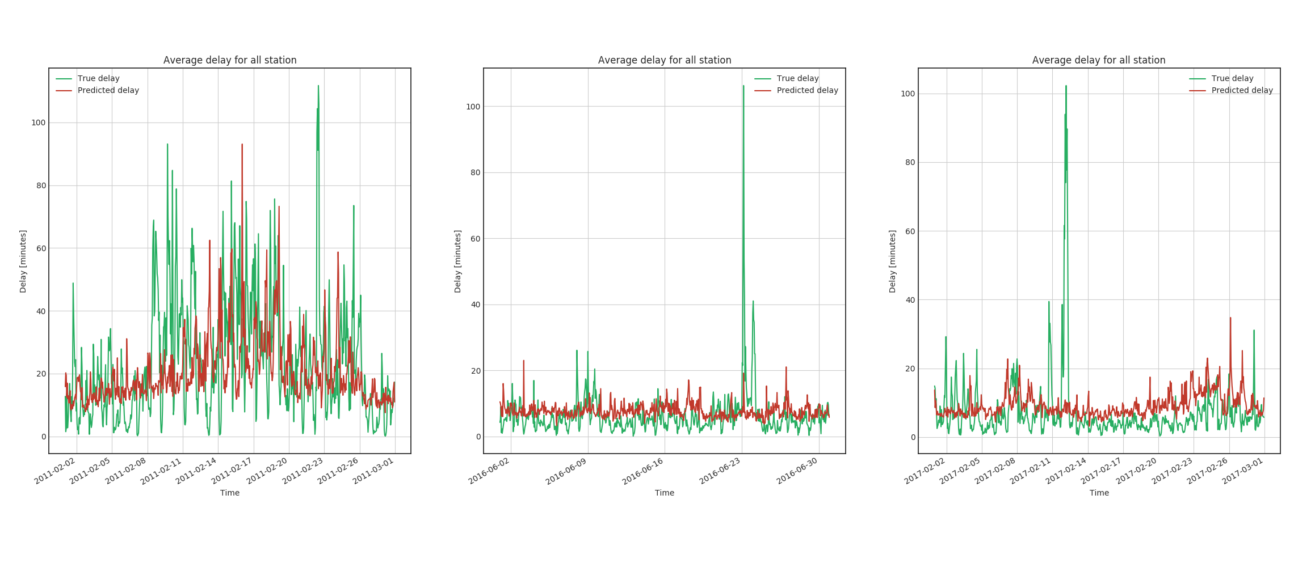
RFR works relatively well
Predicted vs. true delay, average over all stations, average over all stations
100
Delay (minutes)
50
0
Time
02/2018
Time
06/2016
Time
02/2017
Notes:
Message: best RFR prediction followed actual observations relatively well
10

Slide 11
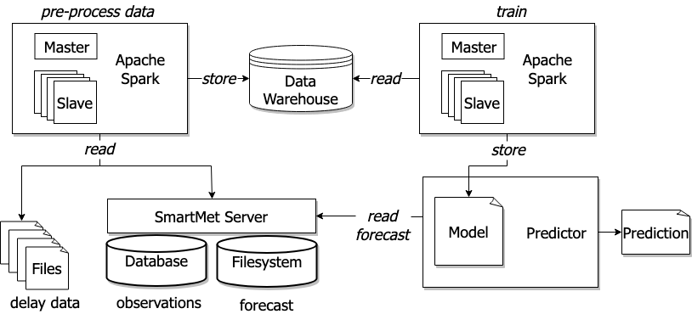
Platform consisted on-premise and Google Cloud components
Google Cloud
FMI

Slide 12


DataProc and BigQuery the most important products
Google Cloud
∫∫∫
BigQuery
Cloud Dataproc
Cloud Dataproc
FMI

Slide 13
Apache Spark Rough estimates of run times
Trains project using Spark framework | Elapsed time usin single server | Elapsed time using Spark
 | 8 cores, 64 Gi memory | 8 workers, 2 cores, 7.5 Gi memory
Data retrieval from SmartMet (5 GB data, 3 million rows, 19 variables) | 2 weeks | 3 days
Random Forest Regression | 1 day | 8 hours
Keras LSTM | ? | ?
Notes:
Our target was to create a delay prediction but also to evaluate the cloud platform
→ we ran the same tasks in our own system and in GCloud
- Rough estimates, setup had a huge effect in run times

Slide 14
Apache Spark Cloud benefits
Cloud benefits (versus on-premise)
Easy to get resources when needed and scale down again
Self-service
Environment scriptable
Fast data loading and storing from BigQuery and to buckets

Slide 15
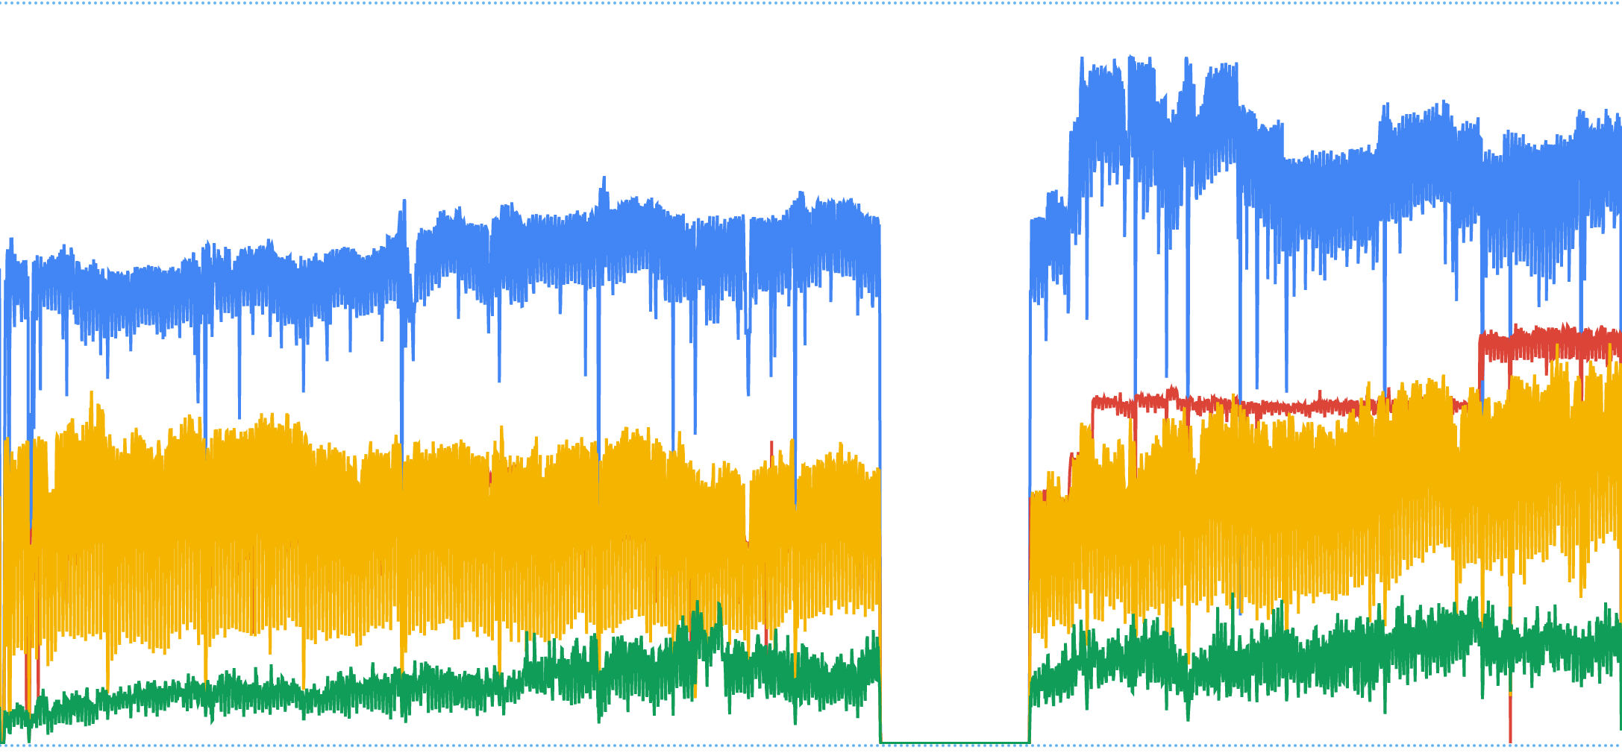

Big Query
Data warehouse to handle large relational data
from google.cloud import bigquery
client = bigquery.Client()
dataset_ref = client.dataset(‘dataset_name’)
table_ref = dataset_ref.table(‘table_name’)
job = client.load_table_from_dataframe(df, table_ref)
job.result()
Careful design needed
Table structure design
Indexing
Partition
Few days of work
BigQuery
Same performance
Notes:
Tried save data to classical postgis (in cloud)
Anyone who would like to reproduce the workflow, would need to use google cloud
Constitutes of the dataset are open but real data is in big query which we can’t open

Slide 16
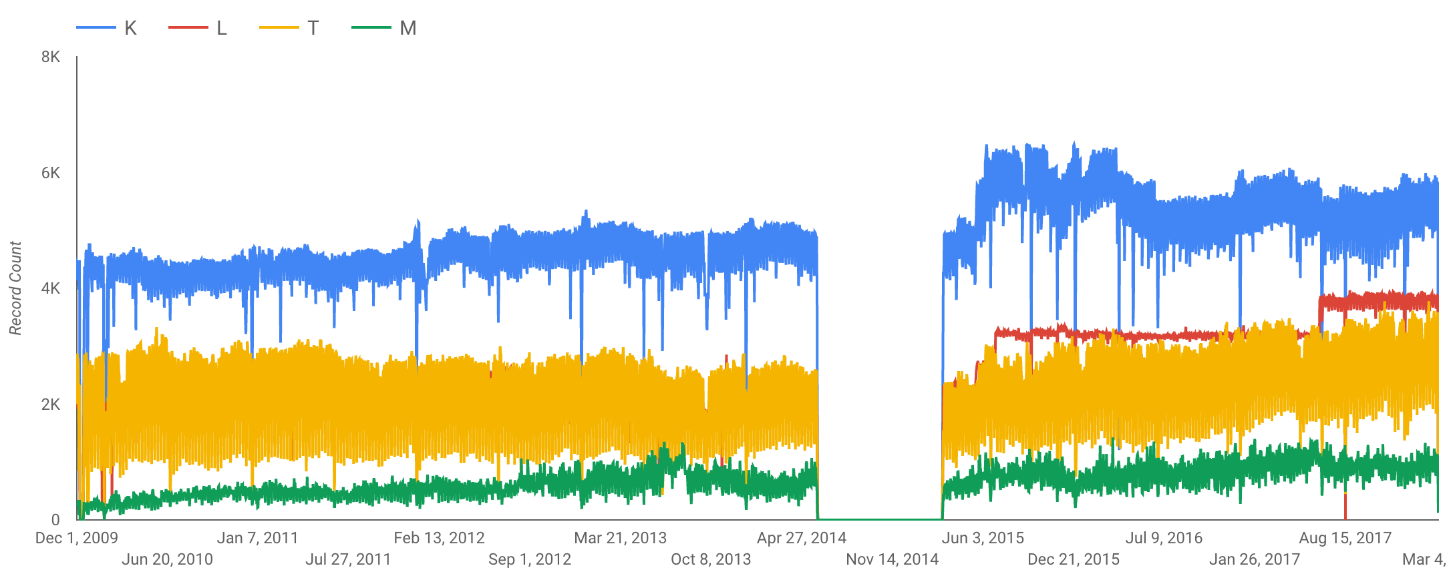
Data Studio
Very nice UI to quickly explore the data
Record count by train type
Notes:
Very fast, very intuitive way to explore any data in BigQuery

Slide 17
General Notes
Costs roughly $3000
Virtually all costs from using Spark
Ability to scale up and down is crucial
Google Cloud easy to use
Especially command line tools convenient

Slide 18
Cloud resources improved the results
Results would had been worse without cloud results
Faster run time enabled more evaluations
Cloud resources ease data handling → more time to develop prediction
BigQuery and Data Studio helped to reveal peculiarities in the data

Slide 19
Main advances are additional services
Additional services
Benefits comes from hosted services, not virtual servers
Self-service → we were able to proceed in agile way
Notes:
Very fast, very intuitive way to explore any data in BigQuery

Slide 20
Scriptable environment really helps reproducibility
#!/bin/bash
# script to create a BigQuery dataset, create cluster,
# run the data retrieval program and finally delate the cluster
echo "Creating bq dataset trains_all"
bq mk trains_all
echo "Creating cluster"
gcloud dataproc clusters create spark3 --master-boot-disk-size 64 --image-version 1.2 --bucket trains-data --master-machine-type n1-standard-4 --num-workers 2 --worker-boot-disk-size 32 --worker-machine-type n1-standard-2 --region europe-north1 --zone europe-north1-c --properties spark:spark.executorEnv.PYTHONHASHSEED=0 --initialization-actions gs://trains-data/bin/install-py3-dataproc.sh
echo "running trains_get_surface_flash_obs_bq.py"
Notes:
We are not there yet but the whole environment should be able to be put up with a script
The script also defines the evnironment very well

Slide 21
Scriptable environment can be moved to the data
#!/bin/bash
# script to create a BigQuery dataset, create cluster,
# run the data retrieval program and finally delate the cluster
echo "Creating bq dataset trains_all"
bq mk trains_all
echo "Creating cluster"
gcloud dataproc clusters create spark3 --master-boot-disk-size 64 --image-version 1.2 --bucket trains-data --master-machine-type n1-standard-4 --num-workers 2 --worker-boot-disk-size 32 --worker-machine-type n1-standard-2 --region europe-north1 --zone europe-north1-c --properties spark:spark.executorEnv.PYTHONHASHSEED=0 --initialization-actions gs://trains-data/bin/install-py3-dataproc.sh
echo "running trains_get_surface_flash_obs_bq.py"
Data 2
Data 1
Notes:
We are not there yet but the whole environment should be able to be put up with a script
The script also defines the evnironment very well

Slide 22
Summary
Cloud services really helped us to improve the results
Code defined environment is a significant part of reproducibility

Slide 23
Questions
roope.tervo@fmi.fi

